Slide 1

Chapter 41 JavaServer Face

Slide 2
Objectives
To explain what JSF is (§41.1).
To create a JSF page using NetBeans (§41.2).
To create JSF UI components (e.g., Static Text, Text Field, Button, Drop Down List, List Box, Radio Button Group, Check Box Group, Text Area, Table) (§41.3).
To use JSF containers Grid Panel, Group Panel, and Layout Panel to group components (§41.4).
To bind data with JSF UI components (§41.5).
To validate input using Message components (§41.6).

Slide 3
What is JSF?
JSF supports visual Web development. You can create a Web user interface using a tool without writing any code. JSF completely separates Web UI from Java code so the application developed using JSF is easy to debug and maintain.

Slide 4
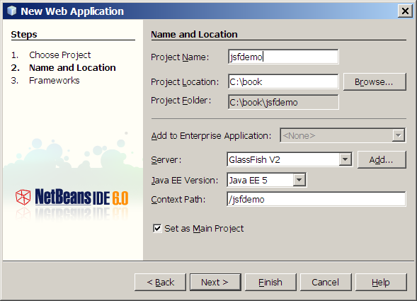
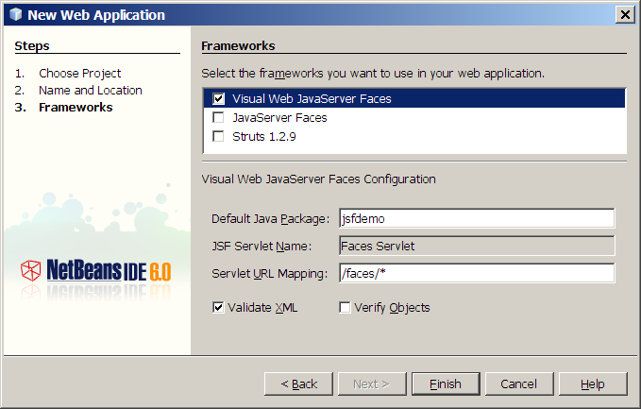
Visual Web Design Using NetBeans
Create a Web project with Visual Web JavaServer Faces.

Slide 5
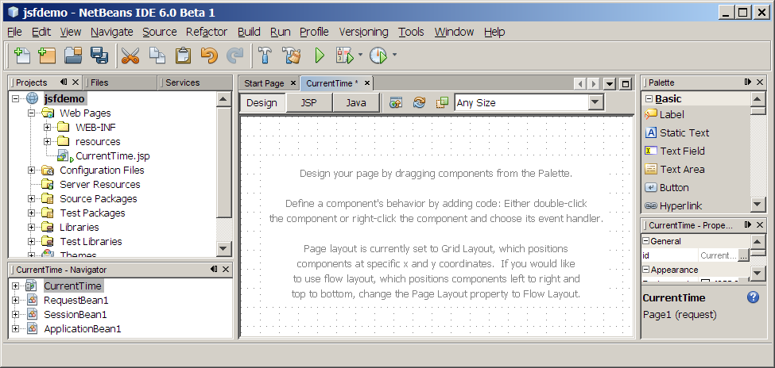
Creating UI in the Design Pane

Slide 6
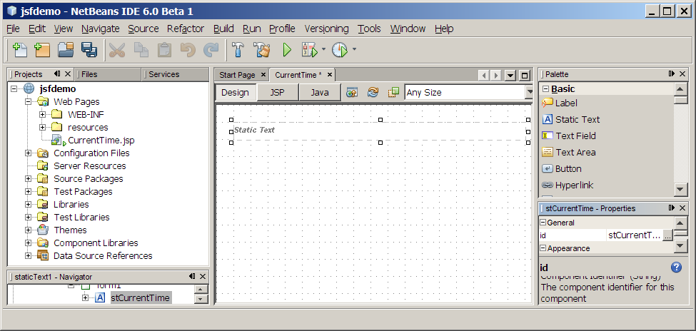
Creating UI in the Design Pane
Drop a Static Text and set its properties

Slide 7
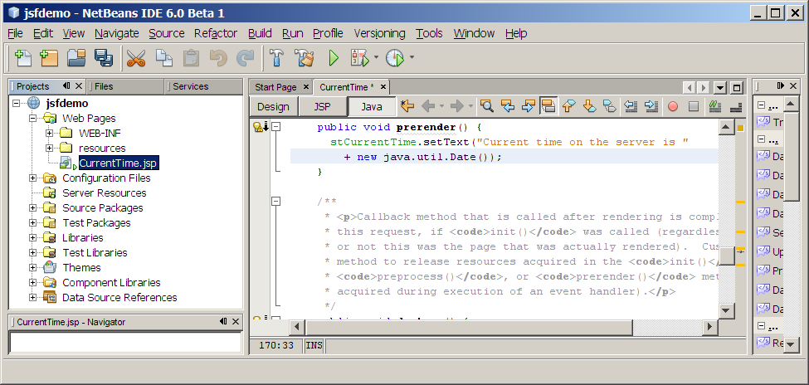
Creating UI in the Design Pane
Write the code in the Java tab.

Slide 8
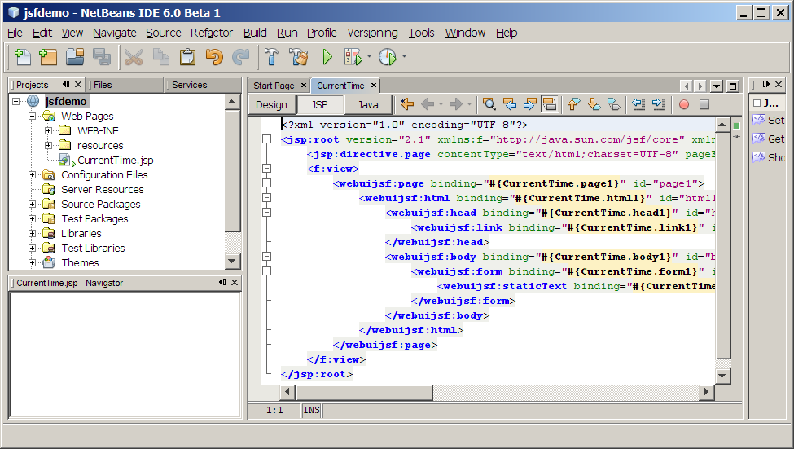
Examining the JSP File
Click the JSP tab to see the JSP file. Whenever you add, remove, or change the UI components in the Design pane, the contents in the JSP are also updated. It is possible to modify the JSP file directly, but it is not recommended for the new users. Modifying the JSP file mistakenly could corrupt the entire project. You can completely ignore the JSP file when using this tool.

Slide 9
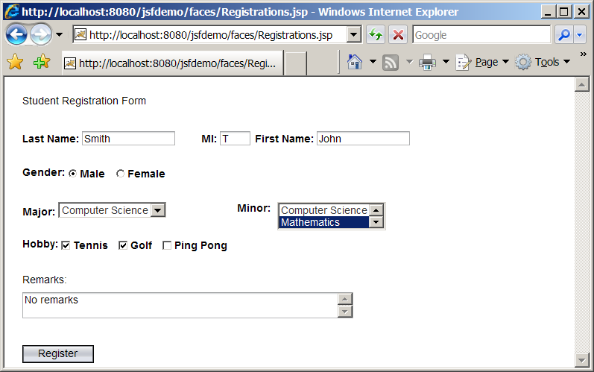
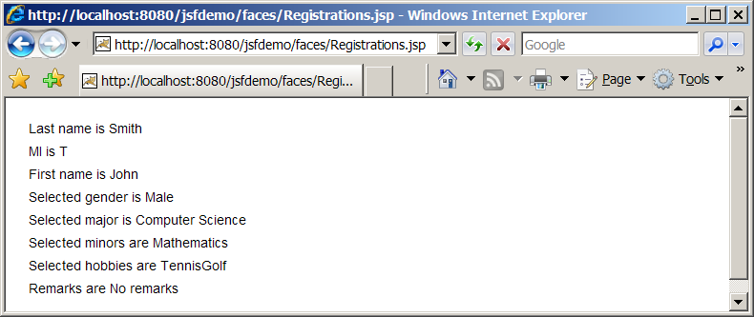
JSF UI Components

Slide 10
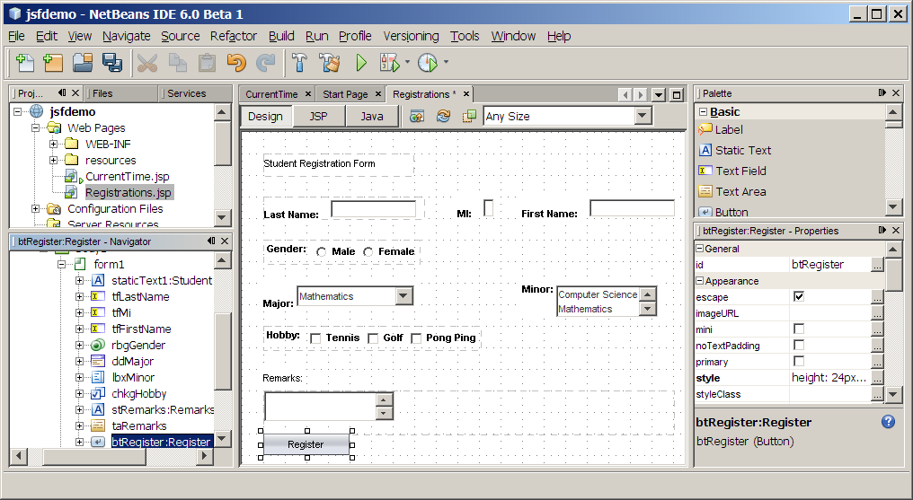
JSF UI Components

Slide 11
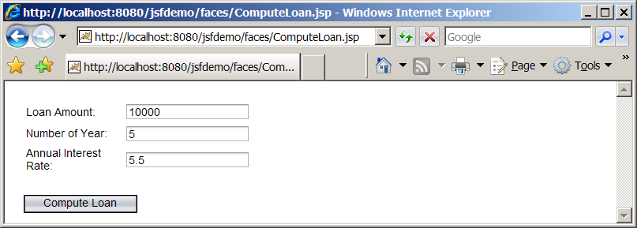
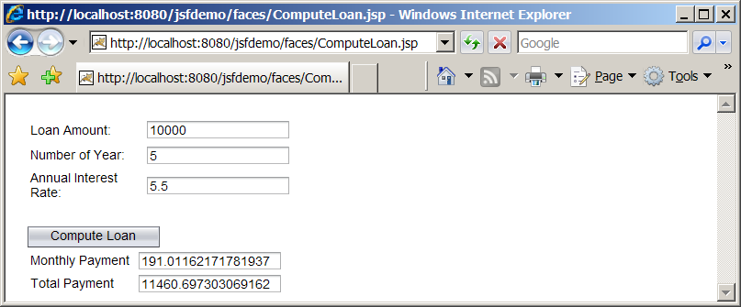
JSF UI Containers

Slide 12
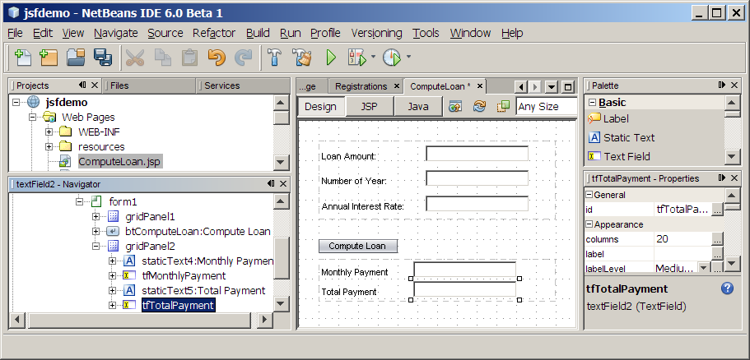
JSF UI Containers

Slide 13
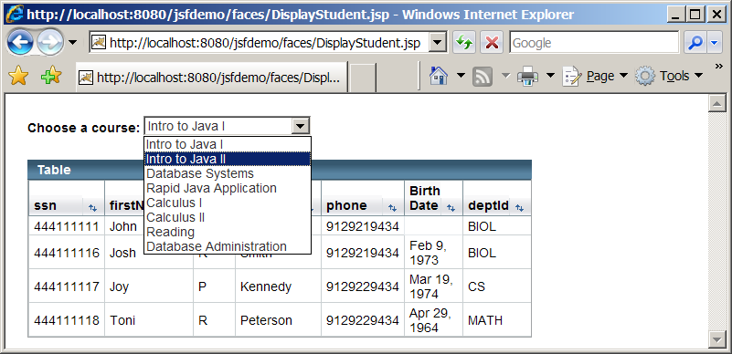
Binding Data with UI Components

Slide 14
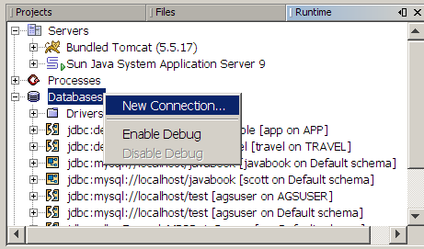
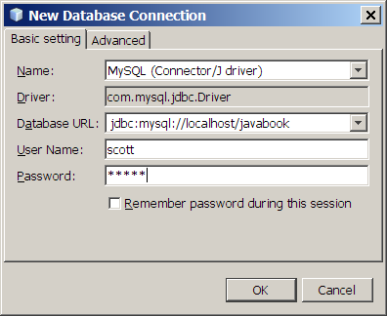
Creating a New Database Connection

Slide 15
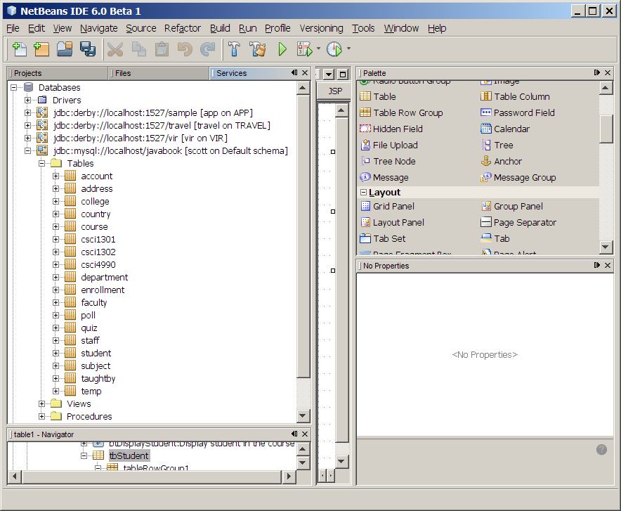
Creating a New Database Connection

Slide 16
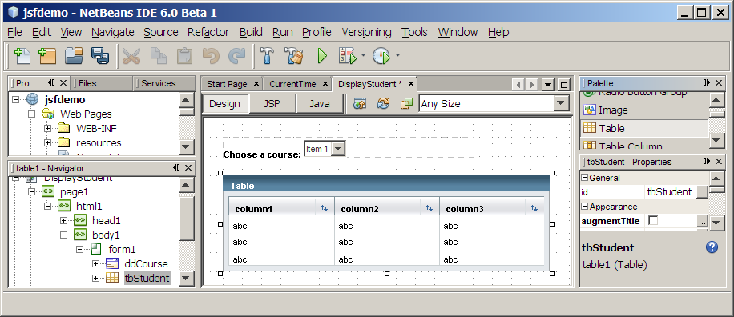
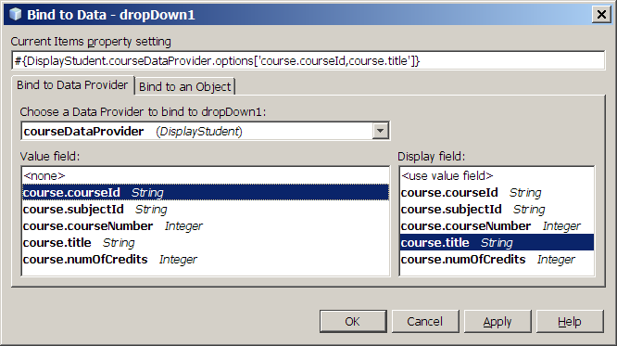
Designing UI

Slide 17
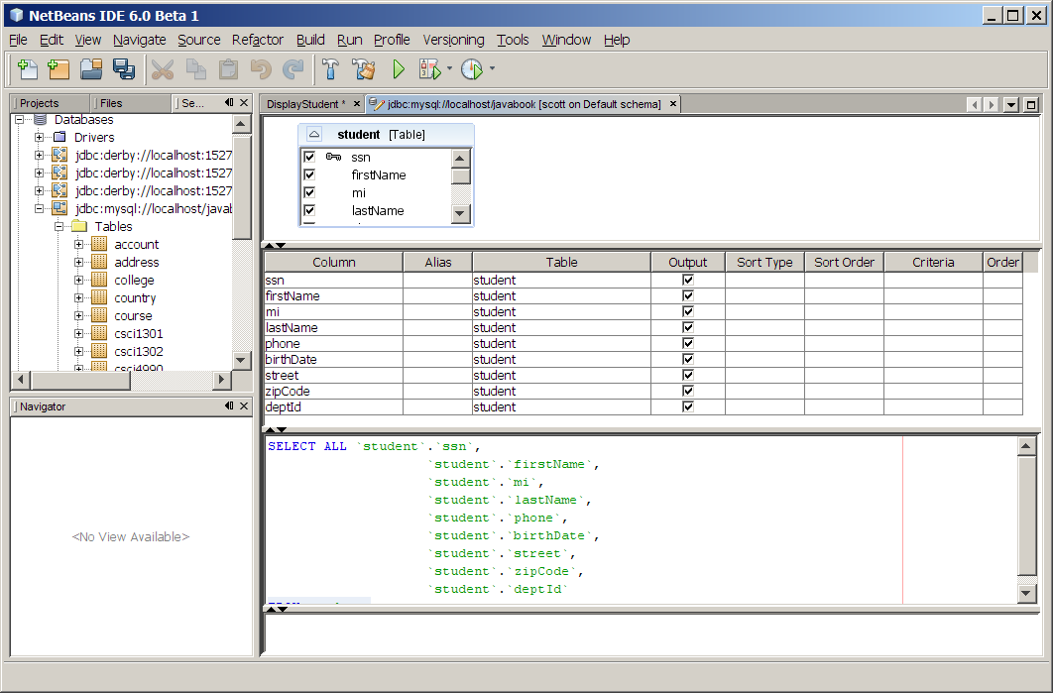
Modifying Query

Slide 18
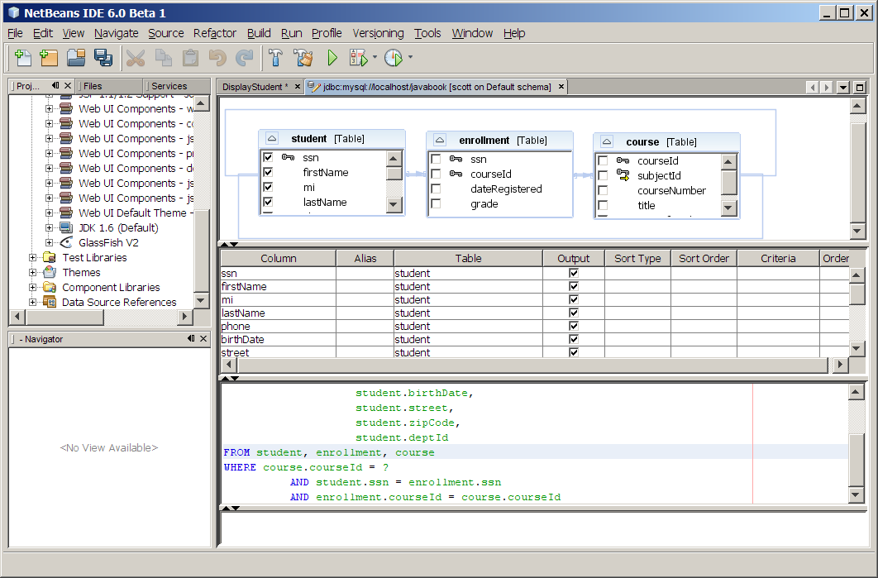
Modifying Query

Slide 19
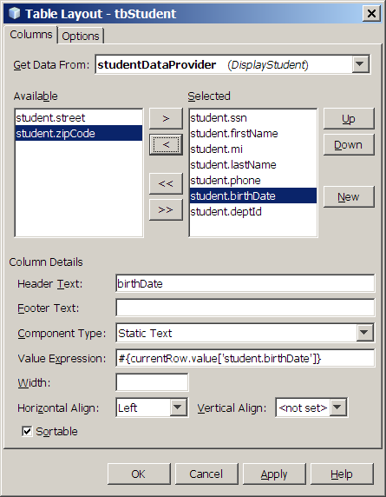
Changing Table Layout

Slide 20
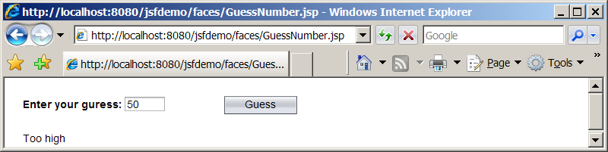


Session Tracking

Slide 21
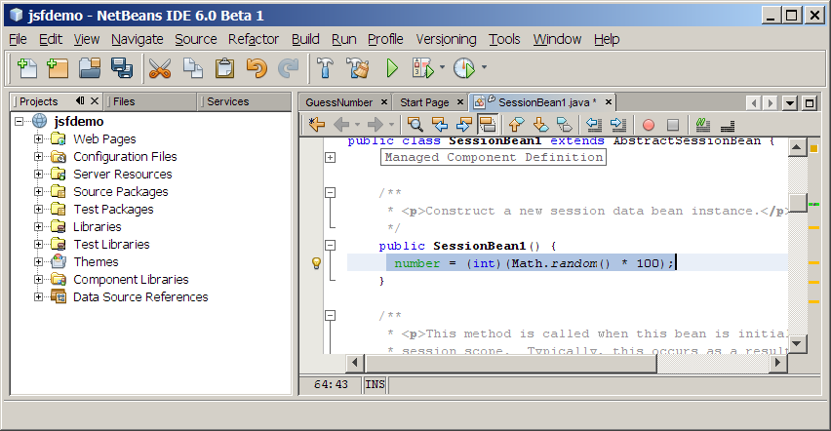
Session Bean

Slide 22
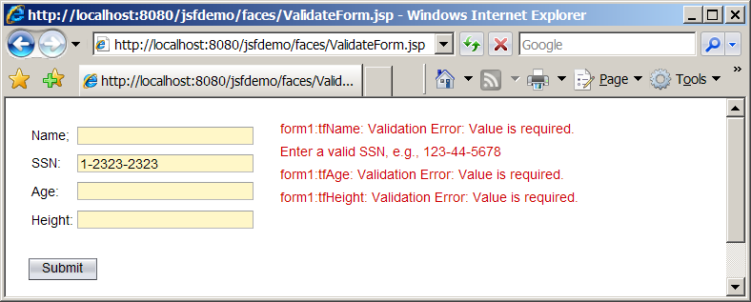
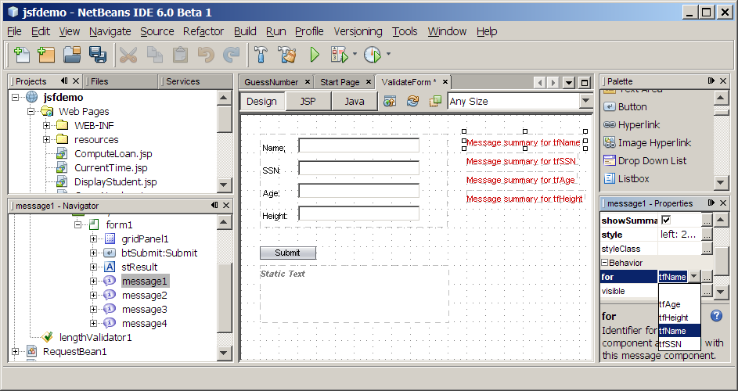
Validating Input

